Slide 1
Digitalizing the tickets and Crowd Management at Public Bus Stands
PIP104 University Project
Final Review
Batch Number: CSE - 26
Under the Supervision of,
Dr. Ramesh Sengodan
Professor
School of Computer Science and Engineering
Presidency University
Roll Number | Student Name
20211CSE0272 | YUKTHI V
20211CSE0268 | CHANDANA S
20211CSE0271 | PARINITHA M
20211CSE0334 | NETHRA K

Slide 2
Introduction
Digitalizing the tickets and crowd management at public bus stands through an Android application offers a practical and user-friendly solution.
The app allows passengers to purchase tickets digitally using QR codes, reducing the need for physical cash and paper tickets. This streamlines the boarding process, minimizes queues, and improves overall convenience.
For crowd management, the app can provide real-time information on bus schedules, passenger load, and station capacity, enabling better flow control and preventing overcrowding.
By using technology that's accessible and efficient, public transport systems can become more organized and commuter-friendly.

Slide 3
Literature Review
Year | Title | Advantage | Drawbacks
2022 | Survey of Automated Fare Collection Solutions in Public Transportation | Automating fare collection reduces inefficiency, while machine learning enhances decision-making and provides deeper customer insights. | High implementation costs for advanced systems and dependency on reliable infrastructure and technologies.
2014 | Mobile enabled bus tracking and ticketing system | Real-time bus tracking enhances passenger convenience, while alerts improve travel planning and ticket management. | Reliant on the accuracy of GPS and RFID, as well as continuous internet and device connectivity.
2018 | Smart bus passengers information and safety management system | It monitors passenger safety and provides real-time updates on bus routes and schedules. | Integration with existing systems can be challenging, and there may be privacy concerns due to the collection of large amounts of data.

Slide 4
Literature Review
Year | Title | Advantage | Drawbacks
2022 | Internet of things-based smart transportation system for smart cities. | The app provides real-time information on bus crowd levels and arrival times, enabling informed travel decisions, while also helping passengers avoid overcrowded buses and locate the nearest bus stop for easier travel.. | The system relies on passengers having smartphones and reliable internet access, with efficiency depending on the real-time accuracy of bus tracking and crowd information.
2022 | Information technology for enhancing transportation in developing countries. | Adopting IT optimizes routes and reduces congestion, enhancing transport efficiency, while fostering new business models and job opportunities through innovation by tech developers and start-ups. | Inadequate infrastructure may hinder the effective use of transportation technologies, while a digital divide could limit access for certain populations due to restricted technology availability.
2016 | Information-based disturbance management for public transport. | Public transport reduces pollution, congestion, and road wear, promoting sustainability, while real-time coordination minimizes delays and disruptions. | Disruptions can spread across transport modes, causing delays, while poor information sharing creates confusion and uncertainty among travelers.

Slide 5
Literature Review
Year | Title | Advantage | Drawbacks
2019 | Understanding the usefulness and acceptance of adaptivity in smart public transport | Tailor-made real-time information enhances comfort, leading to higher acceptance rates as people enjoy the experience more. | Effective adaptivity in technologies requires a robust installation infrastructure, while proper integration is needed to handle passenger psychology; inappropriate adaptation could lead to perceptions of overcrowding.
2020 | An overview of ubiquitous interactive passenger services | Digital services simplify routing, improve ticketing efficiency, and make intermodal transport easier to manage, while future research will focus on personalized and trustworthy services. | Social and interactional aspects are underdeveloped, while privacy and reliability concerns limit full system usage.

Slide 6
Literature Review
Year | Title | Advantage | Drawbacks
2018 | Fool Proof ticketing System for public transport. | RFID systems are affordable and reliable for automation, while two-way authentication helps deter ticketless travel. | Delays in passenger authentication can lead to inefficiencies, while major upgrades may encounter resistance from users.
2019 | Design of public transport stops and stations and its contribution to attractive and accessible public transport. | Well-designed stops enhance usage and urban mobility, beautifying public spaces and attracting foot traffic while promoting inclusion. | Inclusive designs can be expensive and cumbersome in dense areas, while high-traffic stops require continuous upkeep and safety measures.

Slide 7
Research Gaps Identified
Poor Integration of Systems
Inability to Leverage Real-Time Data
Insufficient use of advanced technologies
Privacy and Security Issues
Limitations in UX
Focus on narrow or limited sustainability
Lack of Data Analytics
Resistance to Adoption

Slide 8
Proposed Methodology
A fully integrated application with characteristics like,
The User Interface allows passengers to book tickets easily through the application, access real-time bus location data via Firebase, and contribute to crowd management by uploading images of bus stands. These images are processed using Flask at the backend to determine crowd density, and if overcrowding is detected, a message is sent to the admin for action.
The Driver Interface enables drivers to share their real-time location through Firebase, improving the efficiency of bus tracking for users. Drivers can also scan tickets to ensure safe and efficient passenger boarding.
The Admin Interface provides administrators with tools to manage driver credentials and respond to alerts about crowd density, allowing them to take necessary actions to mitigate overcrowding situations.

Slide 9
Objectives
Enhance passenger convenience.
Reduce operational costs.
Real-time data and insights.
Enable contactless and secure transactions.
Improve crowd management and safety.
Support sustainability and eco-friendly practices.
Implement seamless, paperless ticketing.
Enhance sustainability with digital-only solutions.

Slide 10
System Design and Implementation
1. System Architecture Overview
1. Mobile Client (Android App)
- Development: Android Studio
- Features: E-ticketing, real-time bus tracking, crowd management
- Integrations: Google Maps, Firebase for real-time storage and communication
2. Back-End: Firebase
- Database: Realtime Database for user profiles, bookings, and crowd data
- Authentication: Secure user login and registration
- Cloud Functions: Server-side logic for ticket booking, crowd alerts, etc.

Slide 11
System Design and Implementation
3. External APIs
- Payment Gateway: Stripe, PayPal for secure transactions
- Google Maps API: Real-time bus tracking and route plotting
2. System Design Breakdown
- UI/UX Design: User-friendly with features like login/sign-up, bus schedules, ticket booking, live bus tracking, and crowd management.
- Core Features:
- User Authentication (Firebase)
- E-ticketing and Payments (Stripe/PayPal)
- Real-time Bus Tracking and Crowd Analytics (YOLOv8 for image processing)

Slide 12
System Design and Implementation
3. Firebase Back-End Development
- Cloud Functions:
- Booking logic, bus location updates, and crowd density alerts
- Automated alerts for overcrowding
4. Testing & Deployment
- Testing: Unit, Integration, User Acceptance, and Stress Testing
- Deployment:
- Admin Dashboard on Firebase Hosting
- Android App on Google Play Store

Slide 13
Timeline of Project
Review 1
Review 2
Source code
Review 3
Abstract
Objectives
Initial Report
October 2024
Title
November 2024
Source code
Algorithm
50% Implementation
50% Report
January 2025
Algorithm
100% Implementation
100% Report

Slide 14
Outcomes
Reduced wait times.
Real-time information.
Dynamic bus scheduling.
Cashless transactions.
Better crowd distribution.
Lower maintenance and staffing costs.
Smart city integration.
Increased passenger satisfaction.

Slide 15
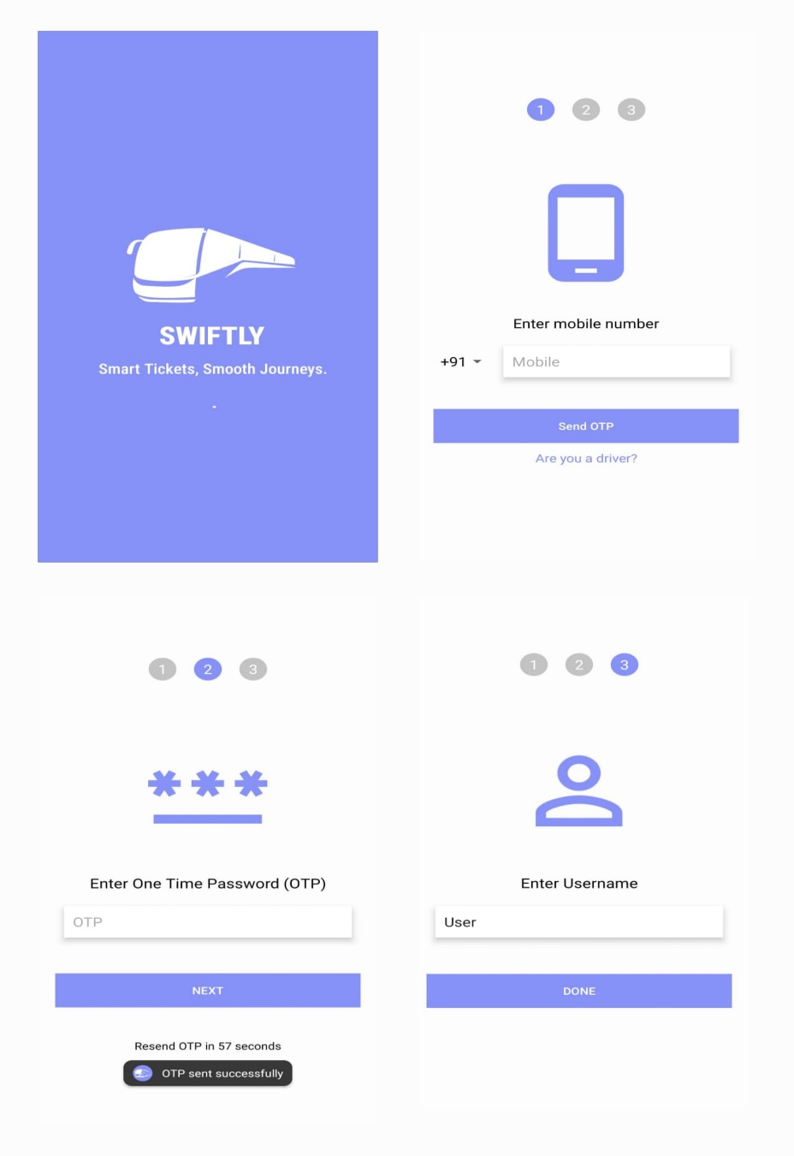
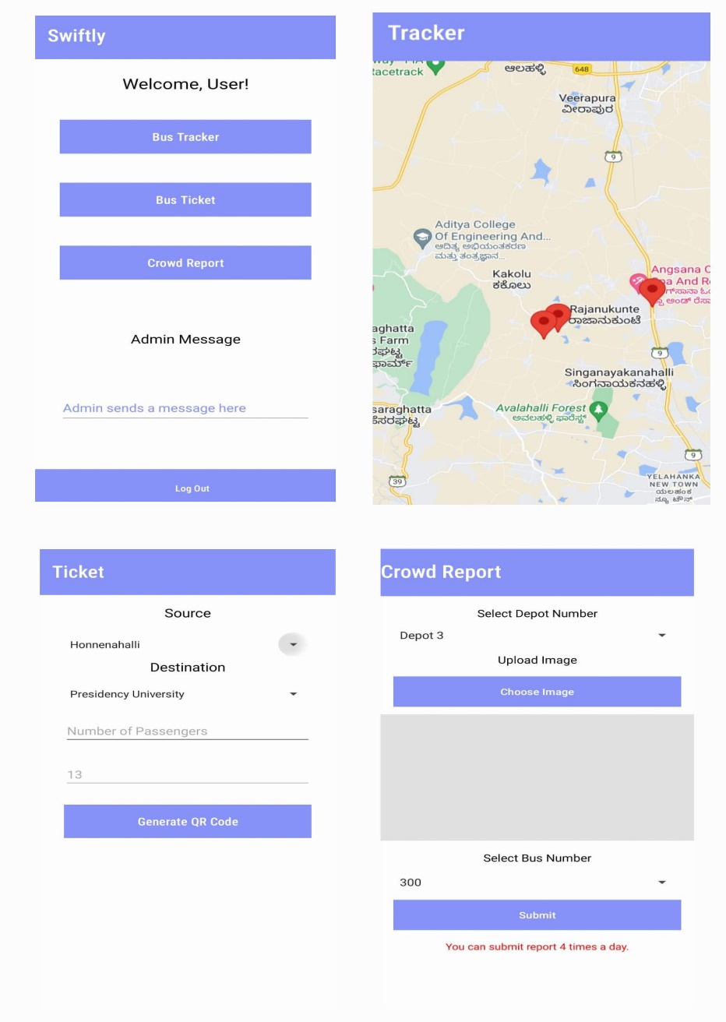
Results Obtained
User Interface
Splash Activity Enter Mobile no User Dashboard Bus Tracker
Enter OTP Enter Username Ticket Booking Crowd Report

Slide 16
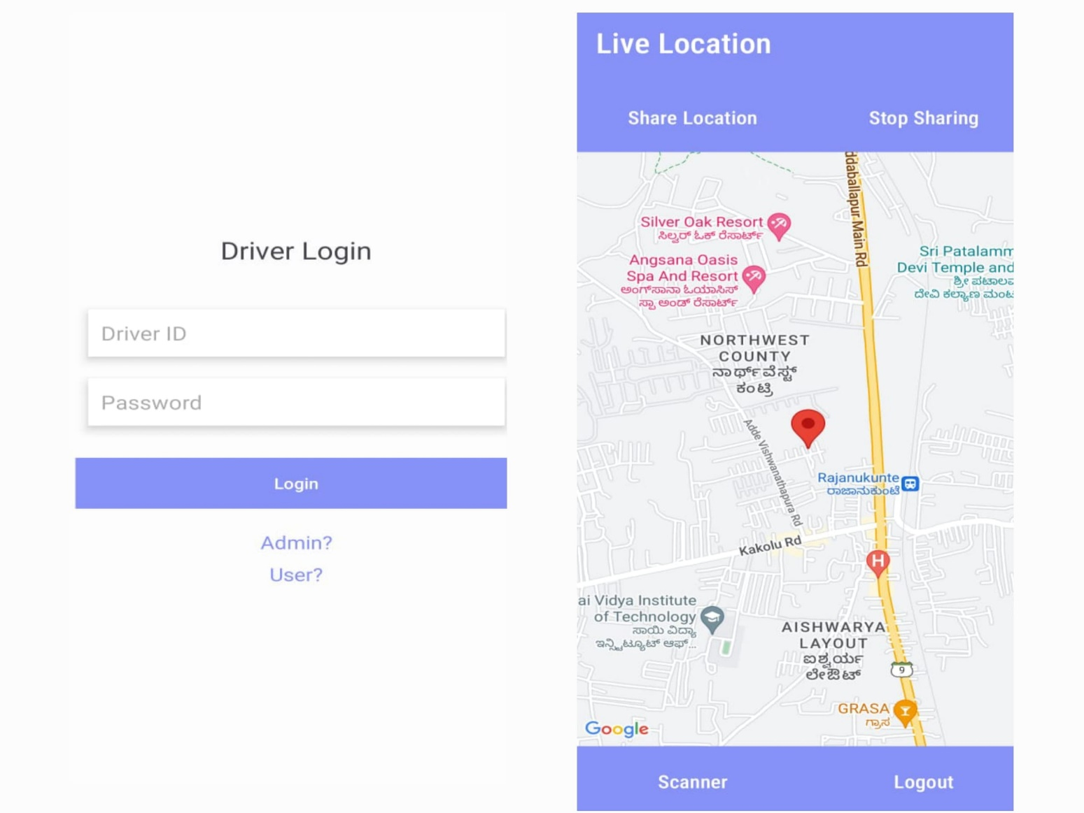
Results
Driver Interface
Driver Login Live Location
and Ticket Scanner

Slide 17
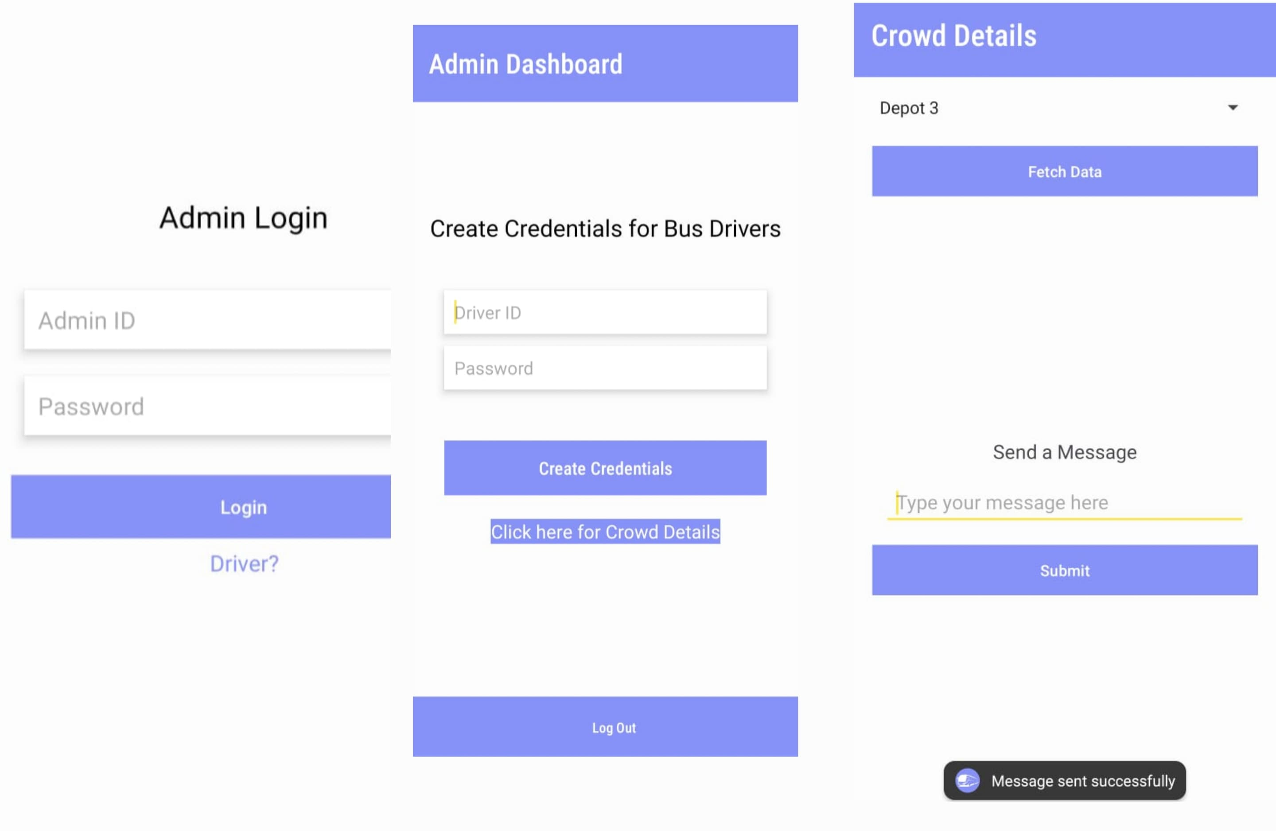
Results
Admin Interface
Admin Login Admin Dashboard Crowd Details

Slide 18
Conclusion
In conclusion, adopting an Android-based solution for digitalizing tickets and managing crowds at public bus stands represents a forward-thinking approach to modernizing public transportation.
By enabling passengers to purchase tickets via mobile apps, this system eliminates the hassle of cash transactions, reduces paper waste, and shortens waiting times.
Furthermore, real-time updates on bus schedules and passenger volumes allow commuters to plan their journeys more efficiently while helping authorities manage crowd flow and avoid congestion during peak hours.
This digital transformation not only streamlines the overall transportation experience but also fosters a safer, more sustainable, and user-centric public transit system, paving the way for more organized urban mobility solutions in the future.

Slide 19
References
M. Bieler, A. Skretting, P. Büdinger and T. -M. Grønli, "Survey of Automated Fare Collection Solutions in Public Transportation," in IEEE Transactions on Intelligent Transportation Systems, vol. 23, no. 9, pp. 14248-14266, Sept. 2022, doi: 10.1109/TITS.2022.3161606.
S. Sankarananrayanan and P. Hamilton, "Mobile enabled bus tracking and ticketing system," 2014 2nd International Conference on Information and Communication Technology (ICoICT), Bandung, Indonesia, 2014, pp. 475-480, doi: 10.1109/ICoICT.2014.6914108.
Sundaramoorthy, Revathy, Yamuna Ilango, and Ananth Kumar Tamilarasan. "Smart bus passengers information and safety management system." International Journal of Pure and Applied Mathematics 119.14 (2018): 795-800
Fantin Irudaya Raj, E., and M. Appadurai. "Internet of things-based smart transportation system for smart cities." Intelligent Systems for Social Good: Theory and Practice. Singapore: Springer Nature Singapore, 2022. 39-50.
Nguyen, Nguyen Phong, and Emmanuel Mogaji. "Information technology for enhancing transportation in developing countries." Management and information technology in the digital era: Challenges and perspectives. Emerald Publishing Limited, 2022. 81-94.
Jevinger, Åse, and Jan A. Persson. "Information-based disturbance management for public transport." Project report 1 (2016).
Keller, Christine, et al. "Understanding the usefulness and acceptance of adaptivity in smart public transport." HCI in Mobility, Transport, and Automotive Systems: First International Conference, MobiTAS 2019, Held as Part of the 21st HCI International Conference, HCII 2019, Orlando, FL, USA, July 26-31, 2019, Proceedings 21. Springer International Publishing, 2019.
Baldauf, Matthias, and Martin Tomitsch. "Pervasive displays for public transport: an overview of ubiquitous interactive passenger services." Proceedings of the 9TH ACM international symposium on pervasive displays. 2020.
Kaushik, Varun, and P. Suhas. "Fool Proof ticketing System for public transport." 2018 3rd International Conference on Communication and Electronics Systems (ICCES). IEEE, 2018.
Kočárková, Dagmar, Vojtěch Novotný, and Jana Jíšová. "Design of public transport stops and stations and its contribution to attractive and accessible public transport." 2019 Smart City Symposium Prague (SCSP). IEEE, 2019.

Slide 20
Publication Details
International Conference on Emerging Research in Computing, Information, Communication, Artificial Intelligence and Machine learning, ERCICAM 2025
07 & 08 March, 2025
Nitte Meenakshi Institute of Technology, Bangalore, India

Slide 21
Thank You

